Slide 1
Bringing Manuscripts into All Levels of the Latin Classroom

Slide 2
Why Do It?
GOAL: Get students to access their knowledge of common vocabulary and Latin endings to read and understand faster
- Deciphering scribal hands, ligatures, and abbreviations requires students to use these skills

Slide 3
How?
CLOZE READING – uses fill in the blanks to test skills like grammar and vocabulary. Can use word banks, multiple choice, etc.
Manuscripts are in many ways premade CLOZE READING exercises.
Manuscripts have varying difficulties, so you can select different tiers of difficulty where appropriate.

Slide 4
What happens when students see a manuscript?
They notice endings
They notice abbreviations
They problem solve

Slide 5
Manuscript Activities You Can Try Right Away!
For quick links for all of the activities go to:
https://github.com/StephanieML/CAAS2017

Slide 6
1) Paleography
Audience: first year and up
Goal: Learners will investigate how paleography relates to language by learning to recognize letterforms and abbreviations in a medieval manuscript
Activity: Give students a transcription and let them compare the transcription with what they see on the page
Recommended manuscript: Bern 318

Slide 7
Try it now!
Turn to page 3 of your packets for a sample lesson I used with my students
I started by introducing the manuscript for about 10 -15 minutes, gave them about 20 minutes on the activity, and spent the remainder of class looking at the passage as a class

Slide 8
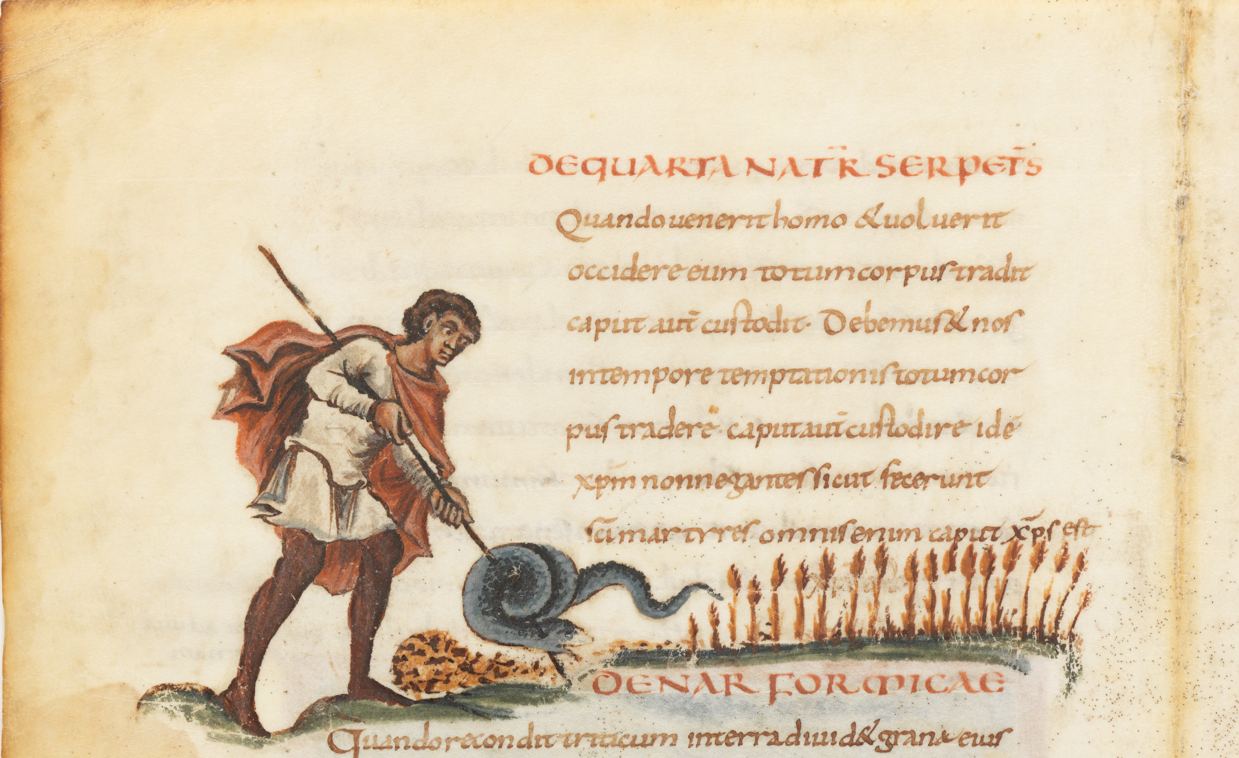

Slide 9
2) Transcription
Audience: end of first year and up
Goal: Learners will investigate the process of textual transmission by transcribing an authentic text
Activity: assign students a passage to transcribe in small groups
Recommended manuscript: Bern 318
Pages 4-5 show a sample project

Slide 10
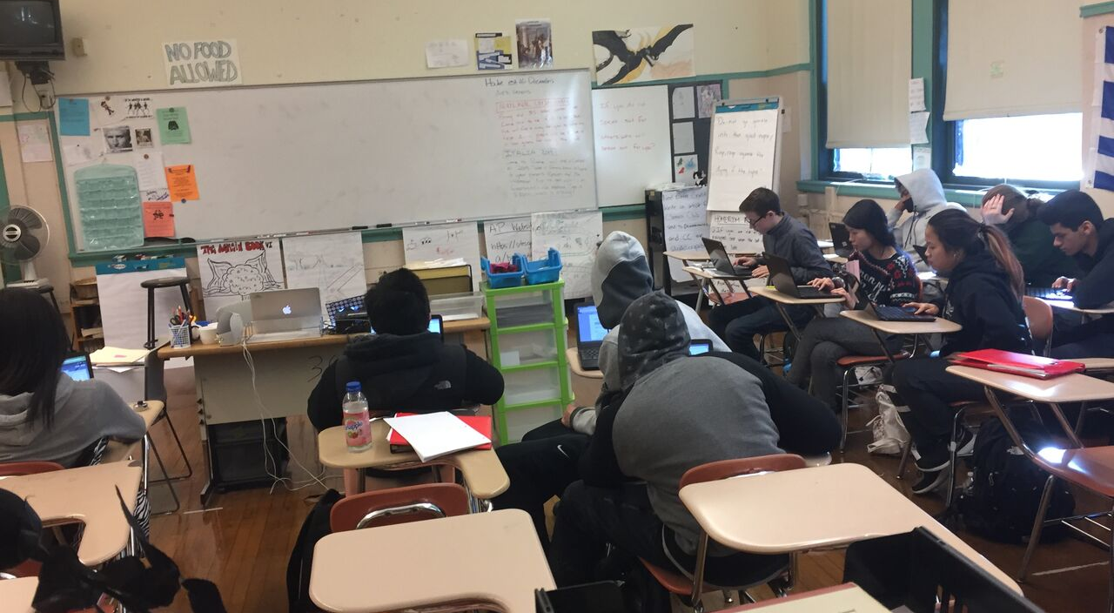
What my students did

Slide 11
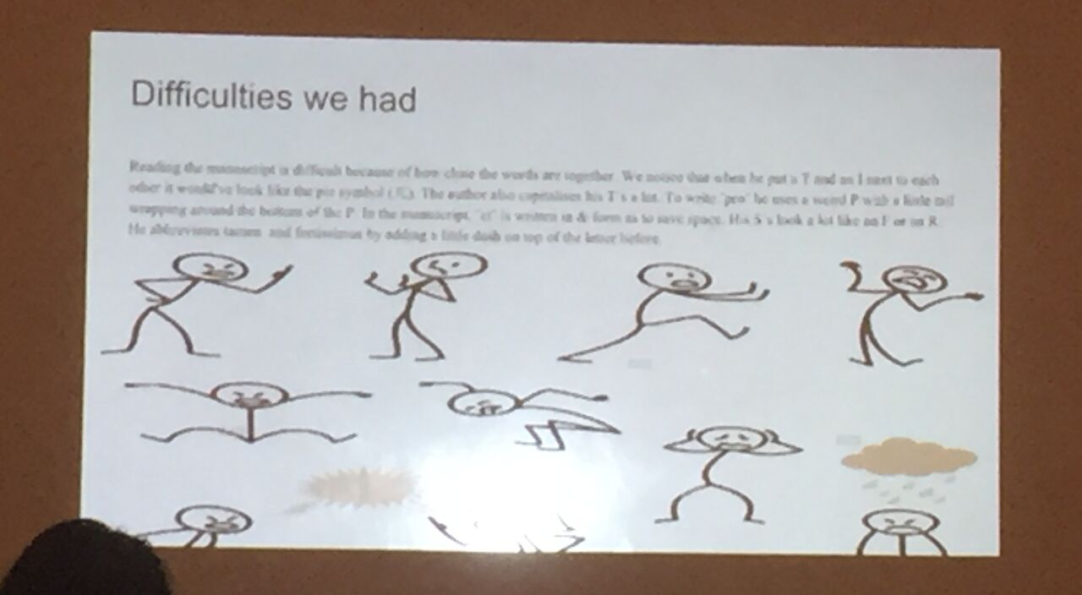
Presentations

Slide 12
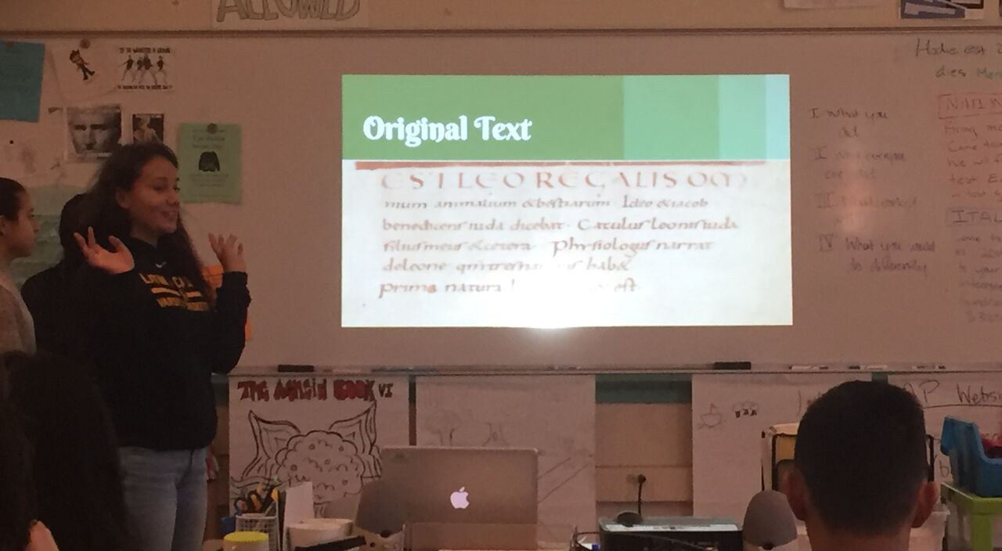
Presentations

Slide 13
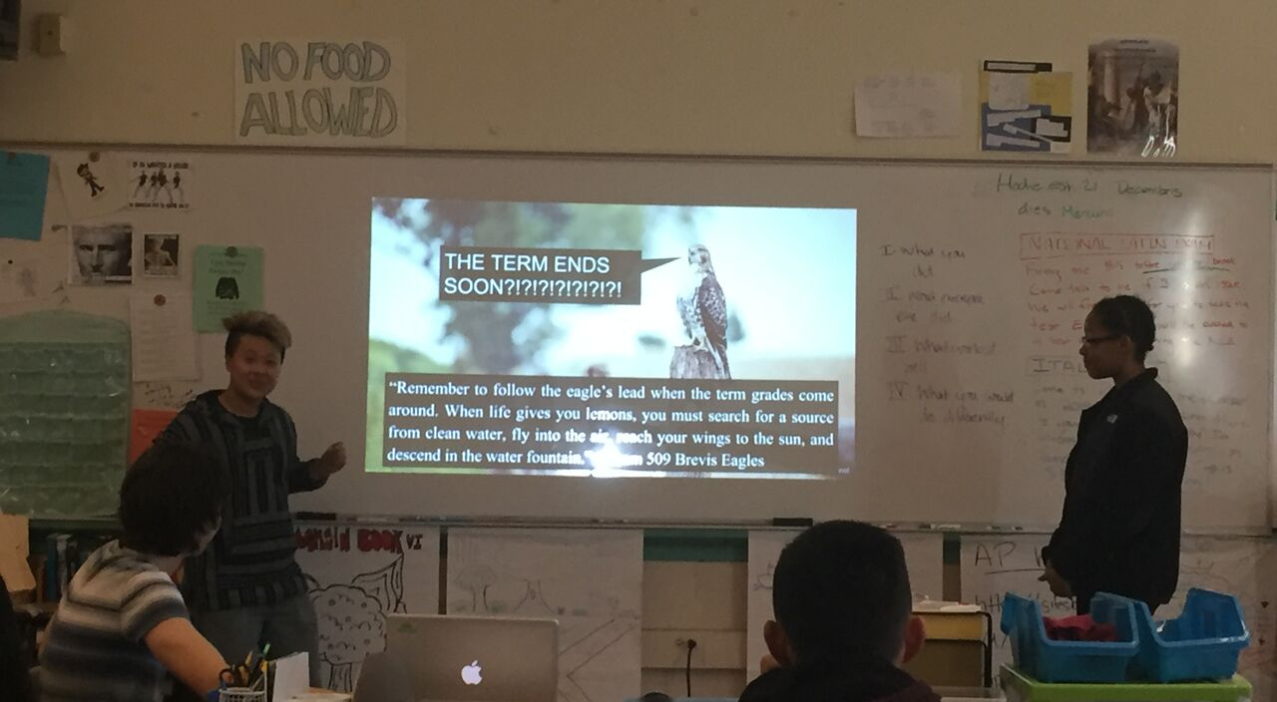
Presentations

Slide 14
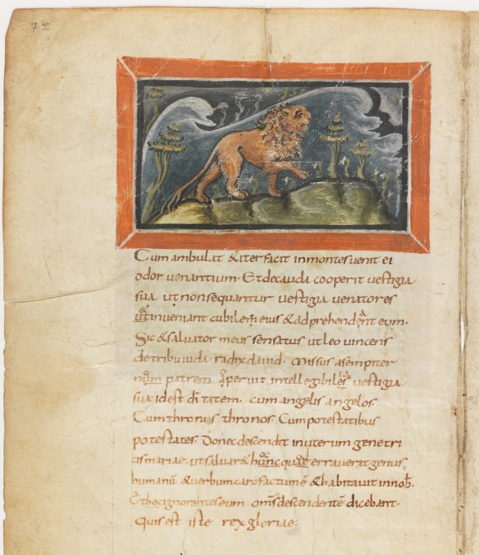
Original Manuscript
In the picture, there’s a lion on the top of a mountain. Behind the lion we can see the waves as if from the ocean which means that he’s standing on top of the world. This can mean that he’s the most powerful and that he's undefeatable.

Slide 15
Transcription
Cum ambulat et iter facit in montes venit ei odor venantium. Et de cauda cooperit vestigia sua ut non sequantur vestigia venatores et ut in-veniant cubilem eius et adprehendant eum.

Slide 16
3) Reading
Audience: end of first year/beginning of second year and up
Goal: Learners will (transcribe and) read an authentic text for understanding
Activity: give a pre-reading activity that works for your students, then have them read the passage and assess comprehension
Resources on page 6

Slide 17
Pre-Reading A - CLOZE
Try the CLOSE reading activity without looking at the transcription on the next page
What skills are being tested with this CLOZE reading? How does this help as a pre-reading activity?

Slide 18

Pre-Reading B - Video

Slide 19
Pre-Reading C – Active Latin
Active Latin is hard, there is nothing wrong with writing scripts and reading
For this activity you can follow along with the script
One rule: try to use as little English as possible. Trust that the pictures and their knowledge will be enough

Slide 20
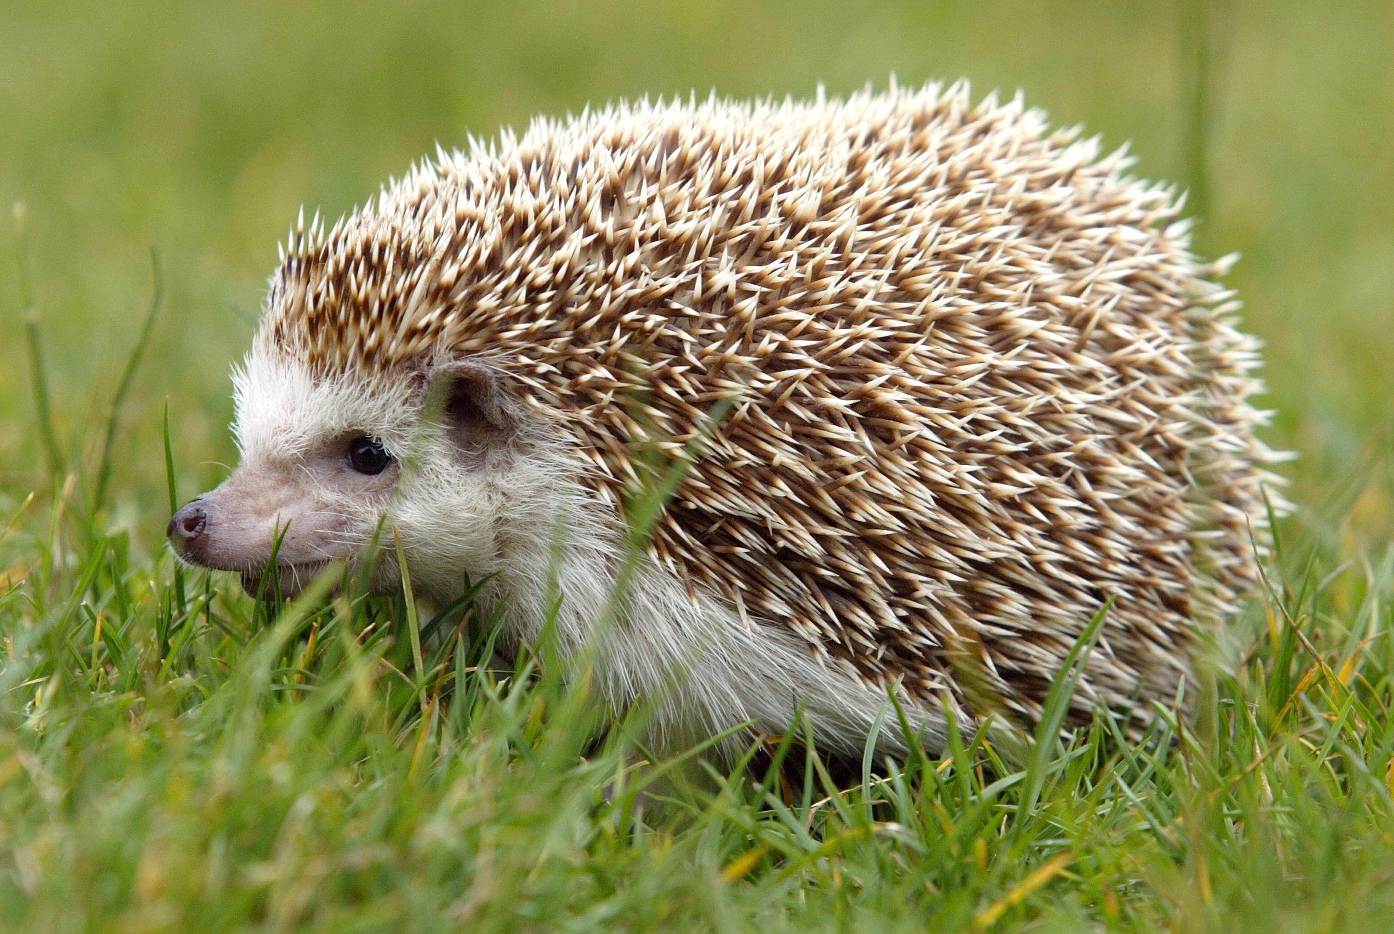
Ericius

Slide 21
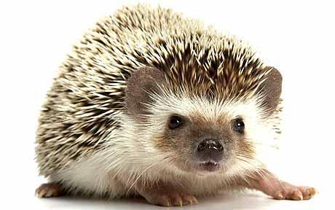
Spinae

Slide 22
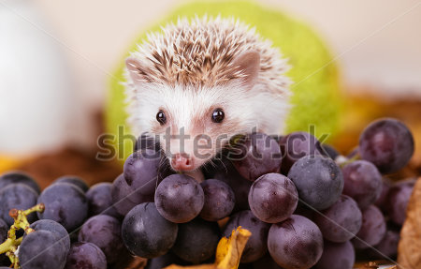
Uvas Edet

Slide 23
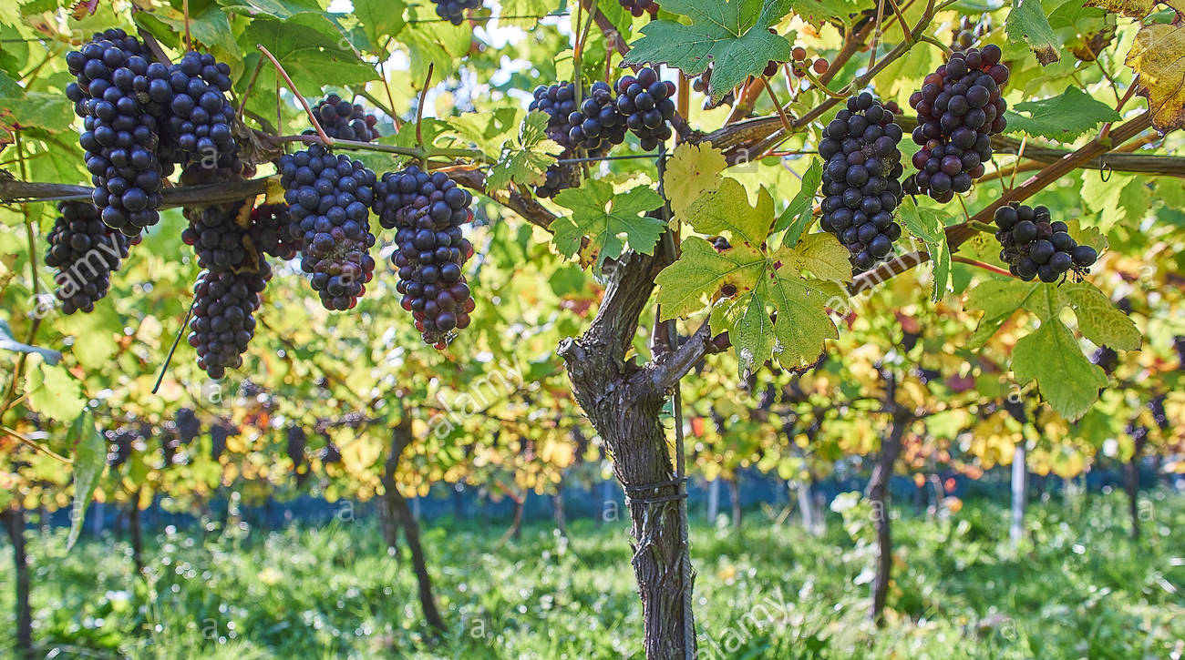
Uvae in vitem

Slide 24
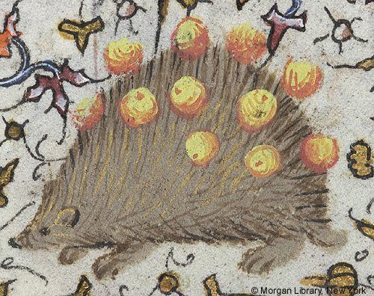
In spinis uvas fert

Slide 25
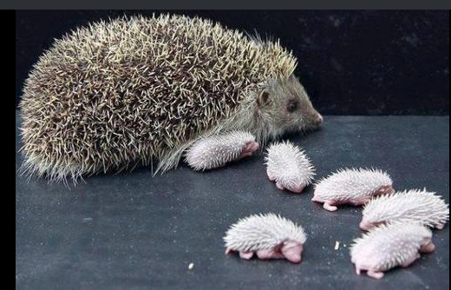
Ericius et filii

Slide 26
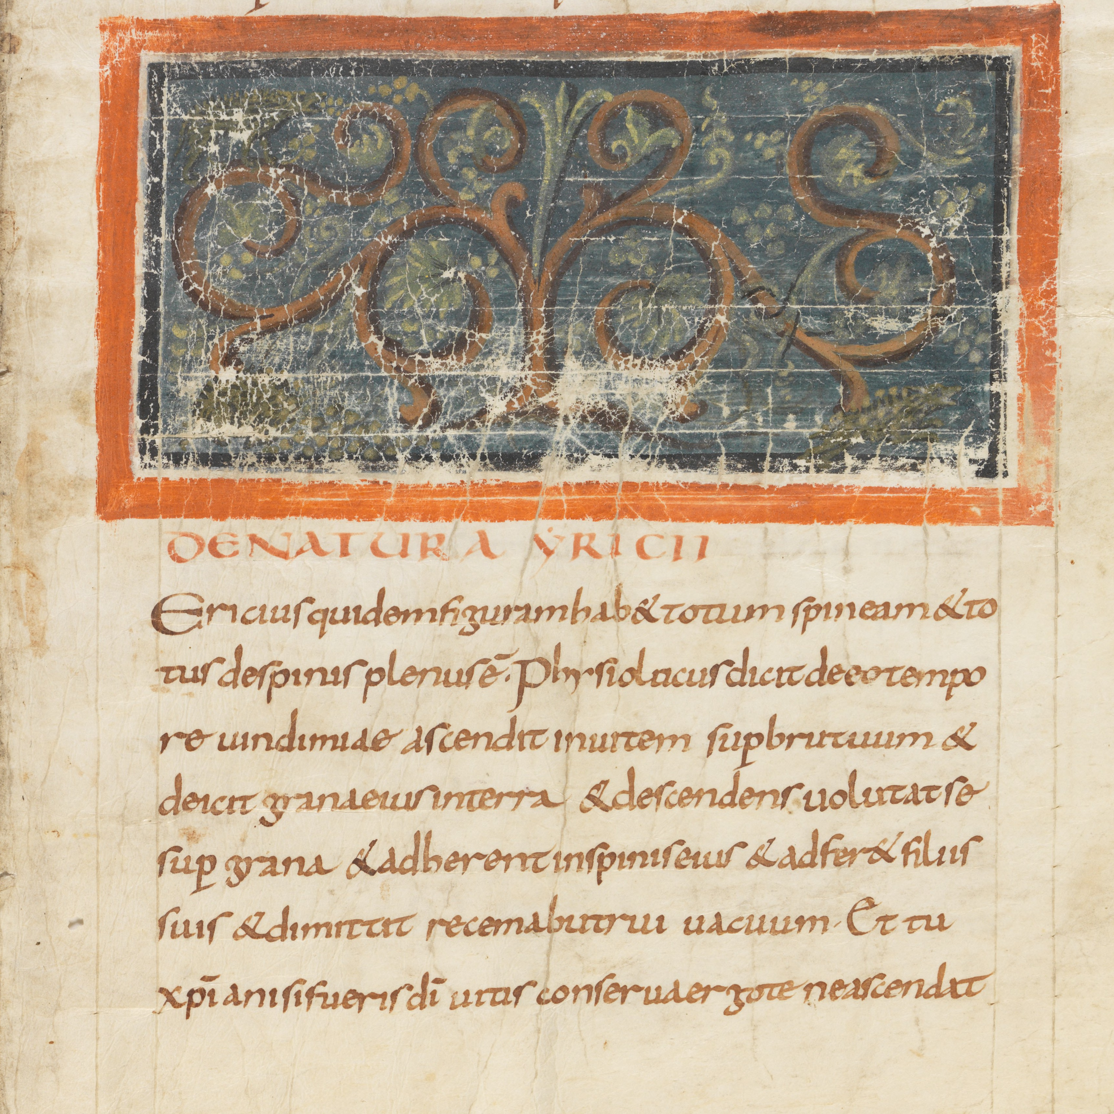

Slide 27
4a) Reception
Audience: 3rd year and up
Goal: Learners will investigate the reception of Classical texts by comparing a modern edition with the edition of a text in a medieval manuscript
Activity: in groups of 2-3 students will compare the manuscript version of the text with their textbook edition
Great as a review or extension activity

Slide 28
Try it!
Starting on page 7 of your packet you have the text of the De Bello Gallico 1.1-7
With a partner, pick your favorite section and find it in the manuscript (we will be around to help you find it if you’re stuck)
Mark differences and focus on the questions on page 2 in your packet.
If you don’t have a device with you, I will put the first section up in the next slide.

Slide 29
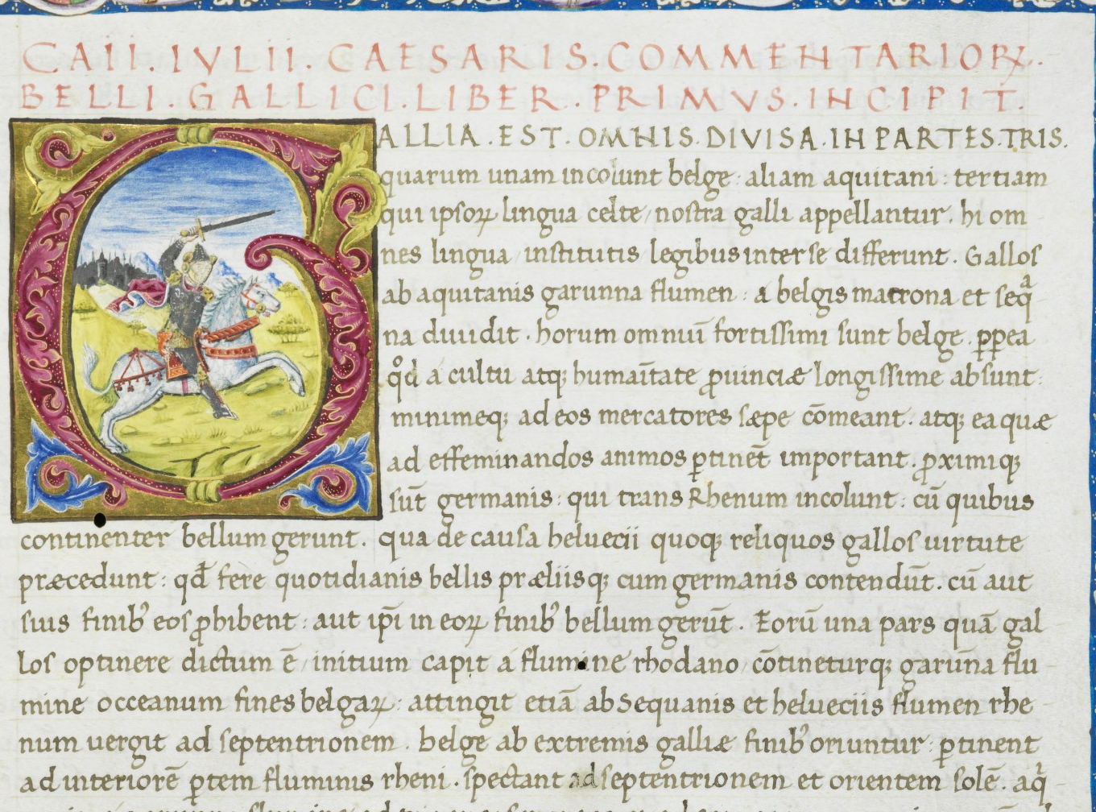

Slide 30
4b) Reception
Audience: 3rd year and up
Goal: Learners will investigate the reception of Classical texts by reading a scholarly commentary of a text
Activity: in groups of 2-3 students will transcribe, translate, and discuss a commentary text
Recommended text: Servius Cod. Sang. 861
Example from Aeneid 6.17

Slide 31
